Slide 1
Classification
Model Overfitting

Slide 2
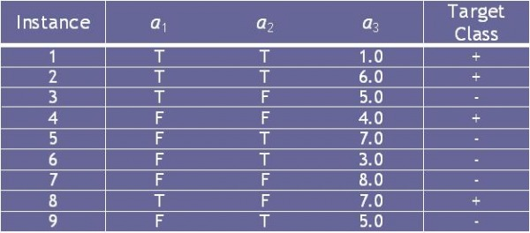
Consider the training examples shown in Table 4.8 for a binary classification problem.
Table 4.8 Data Set
(a) What is the entropy of this collection of training examples with respect to the positive class?
(b) What are the information gains of a1 and a2 relative to these training examples?
(c) For a3, which is a continuous attribute, compute the information gain for every possible split.
(d) What is the best split (between a1, a2, and a3) according to the information gain?
(e) What is the best split (between a1, and a2) according to the classification error rate?
(f) What is the best split (between a1 and a2) according to the Gini index?

Slide 3
Expressiveness
A classifier defines a function that discriminates between two (or more) classes.
The expressiveness of a classifier is the class of functions that it can model, and the kind of data that it can separate
When we have discrete (or binary) values, we are interested in the class of boolean functions that can be modeled
If the data-points are real vectors we talk about the decision boundary that the classifier can model

Slide 4
Expressiveness
Decision tree provides expressive representation for learning discrete-valued function
But they do not generalize well to certain types of Boolean functions
Example: parity function:
Class = 1 if there is an even number of Boolean attributes with truth value = True
Class = 0 if there is an odd number of Boolean attributes with truth value = True
For accurate modeling, must have a complete tree
Not expressive enough for modeling continuous variables
Particularly when test condition involves only a single attribute at-a-time

Slide 5
Decision Boundary
Border line between two neighboring regions of different classes is known as decision boundary
Decision boundary is parallel to axes because test condition involves a single attribute at-a-time

Slide 6
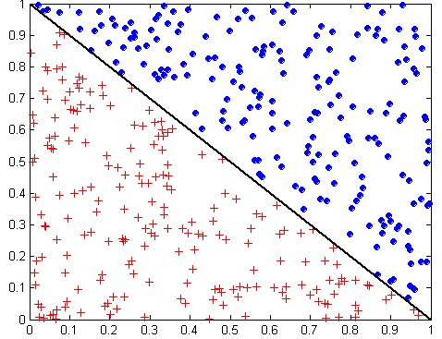
Oblique Decision Trees
x + y < 1
Class = +
Class =
Test condition may involve multiple attributes
More expressive representation
Finding optimal test condition is computationally expensive

Slide 7
Overfitting the Data
A classification model commits two kinds of errors:
Training Error (TE) (resubstitution error , apparent error)
Generalization Errors (GE)
A good classification model must have low TE as well as low GE
A model that fits the training data too well can have high GE than a model with high TE
This problem is known as model overfitting

Slide 8
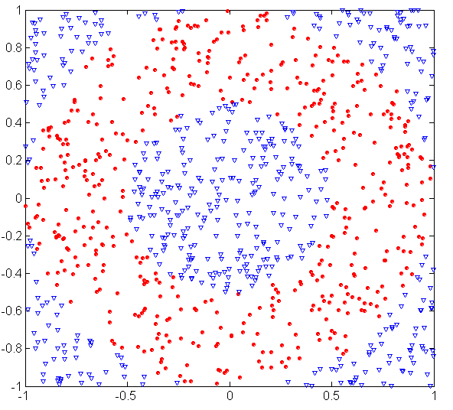
Underfitting and Overfitting (Example)
500 circular and 500 triangular data points.
Circular points:
0.5 ≤ sqrt(x₁²+x₂²) ≤ 1
Triangular points:
sqrt(x₁²+x₂²) > 0.5 or
sqrt(x₁²+x₂²) < 1

Slide 9
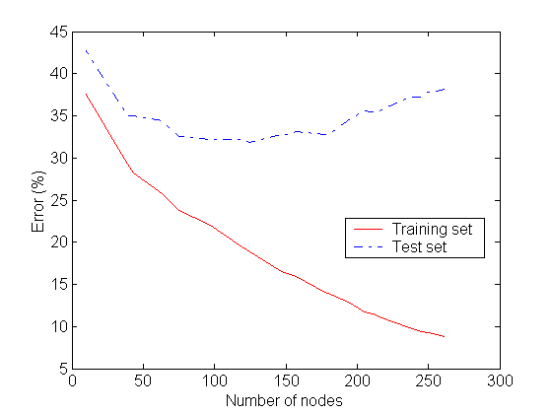
Underfitting and Overfitting
Underfitting
Overfitting
Underfitting: when model is too simple, both training and test errors are large
Overfitting: when model is too complex it models the details of the training set and fails on the test set
Notes:
Underfitting: when model is too simple, both training and test errors are large. TE & GE are large when the size of the tree is very small.
It occurs because the model is yet to learn the true structure of the data and as a result it performs poorly on both training and test sets

Slide 10
Overfitting the Data
When a decision tree is built, many of the branches may reflect anomalies in the training data due to noise or outliers.
We may grow the tree just deeply enough to perfectly classify the training data set.
This problem is known as overfitting the data.

Slide 11
Overfitting the Data
TE of a model can be reduced by increasing the model complexity
Leaf nodes of the tree can be expanded until it perfectly fits the training data
TE for such a complex tree = 0
GE can be large because the tree may accidently fit noise points in the training set
Overfitting & underfitting are two pathologies that are related to model complexity

Slide 13
Occam’s Razor
Given two models of similar generalization errors, one should prefer the simpler model over the more complex model
For complex models, there is a greater chance that it was fitted accidentally by errors in data
Therefore, one should include model complexity when evaluating a model

Slide 14
Definition
A decision tree T is said to overfit the training data if there exists some other tree T’ which is a simplification of T, such that T has smaller error than T’ over the training set but T’ has a smaller error than T over the entire distribution of the instances.

Slide 15
Problems of Overfitting
Overfitting can lead to many difficulties:
Overfitted models are incorrect.
Require more space and more computational resources
Require collection of unnecessary features
They are more difficult to comprehend

Slide 16
Overfitting
Overfitting can be due to:
Presence of Noise
Lack of representative samples

Slide 17
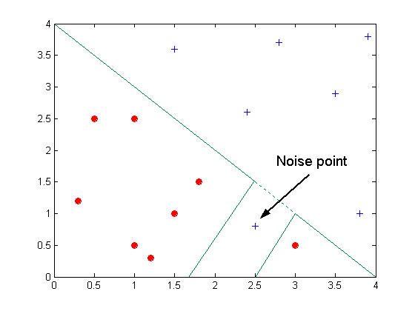
Overfitting due to Noise
Decision boundary is distorted by noise point

Slide 18
Overfitting: Example
Presence of Noise: Training Set
Name | Body Temperature | Gives Birth | 4-legged | Hibernates | Class Label (mammal)
Porcupine | Warm Blooded | Y | Y | Y | Y
Cat | Warm Blooded | Y | Y | N | Y
Bat | Warm Blooded | Y | N | Y | N*
Whale | Warm Blooded | Y | N | N | N*
Salamander | Cold Blooded | N | Y | Y | N
Komodo Dragon | Cold Blooded | N | Y | N | N
Python | Cold Blooded | N | N | Y | N
Salmon | Cold Blooded | N | N | N | N
Eagle | Warm Blooded | N | N | N | N
Guppy | Cold Blooded | Y | N | N | N
*mislabeled records

Slide 19
Overfitting: Example
Presence of Noise:Test Set
Name | Body Temperature | Gives Birth | 4-legged | Hibernates | Class Label (mammal)
Human | Warm Blooded | Y | N | N | Y
Pigeon | Warm Blooded | N | N | N | N
Elephant | Warm Blooded | Y | Y | N | Y
Leopard Shark | Cold Blooded | Y | N | N | N
Turtle | Cold Blooded | N | Y | N | N
Penguin | Cold Blooded | N | N | N | N
Eel | Cold Blooded | N | N | N | N
Dolphin | Warm Blooded | Y | N | N | Y
Spiny Anteater | Warm Blooded | N | Y | Y | Y
Gila Monster | Cold Blooded | N | Y | Y | N
Table taken from text book (Tan, Steinbach, Kumar)

Slide 20
Overfitting: Example
Presence of Noise: Models
Body Temp
Body Temp
Warm blooded
Cold blooded
Warm blooded
Cold blooded
Gives Birth
Non-mammals
Gives Birth
Non-mammals
Yes
No
Yes
No
4-legged
Non-mammals
Mammals
Non-mammals
Yes
No
Model M2
TE = 20%, GE=10%
Mammals
Non-mammals
Model M1
TE = 0%, GE=30% Find out why?
Figure taken from text book (Tan, Steinbach, Kumar)

Slide 21
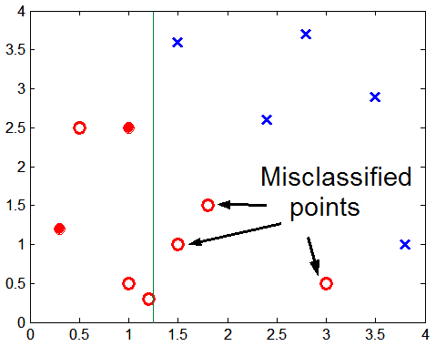
Overfitting due to Insufficient Examples
Lack of data points in the lower half of the diagram makes it difficult to predict correctly the class labels of that region
- Insufficient number of training records in the region causes the decision tree to predict the test examples using other training records that are irrelevant to the classification task
Figure taken from text book (Tan, Steinbach, Kumar)

Slide 22
Overfitting: Example
Lack of representative samples: Training Set
Name | Body Temperature | Gives Birth | 4-legged | Hibernates | Class Label (mammal)
Salamander | Cold Blooded | N | Y | Y | N
Eagle | Warm Blooded | N | N | N | N
Guppy | Cold Blooded | Y | N | N | N
Poorwill | Warm blooded | N | N | Y | N
Platypus | Warm blooded | N | Y | Y | Y
Table taken from text book (Tan, Steinbach, Kumar)

Slide 23
Overfitting: Example
Lack of representative samples: Training Set
Body Temp
Warm blooded
Cold blooded
Hibernates
Non-mammals
Model M3
TE = 0%, GE=30% Find out why?
Yes
No
4-legged
Non-mammals
Yes
No
Mammals
Non-mammals
Figure taken from text book (Tan, Steinbach, Kumar)

Slide 24
Estimating Generalization Errors
Re-substitution errors: error on training (Σ e(t))
Generalization errors: error on testing (Σ e’(t))
Methods for estimating generalization errors:
Optimistic approach: e’(t) = e(t)
Pessimistic approach:
For each leaf node: e’(t) = (e(t)+0.5)
Total errors: e’(T) = e(T) + N × 0.5 (N: number of leaf nodes)
For a tree with 30 leaf nodes and 10 errors on training (out of 1000 instances): Training error = 10/1000 = 1%
Generalization error = (10 + 30×0.5)/1000 = 2.5%
Reduced error pruning (REP):
uses validation data set to estimate generalization error

Slide 26
Minimum Description Length (MDL)
Cost(Model,Data) = Cost(Data|Model) + Cost(Model)
Cost is the number of bits needed for encoding.
Search for the least costly model.
Cost(Data|Model) encodes the misclassification errors.
Cost(Model) uses node encoding (number of children) plus splitting condition encoding.

Slide 27
Minimum Description Length Algorithm
Cost of Encoding Tree
The cost of encoding the tree comprises of three costs
The cost of the encoding the structure of the tree: structure can be encoded by single bit in order to specify whether a node is internal or leaf node. Non-leafà1, leafà0.
The cost of encoding the each split: involves specifying the attribute that is used to split the node and the value for the attribute.
splitting attribute can be encoded à log a bits
where total number of splitting pts are a

Slide 28
MDL Algorithm……
Cost of Encoding Tree
For categorical attribute 2^{ν} different subsets of values
cost encoding the split is C_{split}(n)=log(2^{ν}-2) bits
For numeric attribute the cost of encoding the split is
C_{split}(n) =log(ν-1) with ν distinct values
The cost of encoding the classes of data records in each leaf of the tree: for the cost of encoding the classes of data records the following equation is used
C(T)=Σ_{i} n_{i} log(n/n_{i} )+((m-1)/2) log(n/2)+log(π^{m/2}/Γ(m/2))
where m is the number of the classes, n_{i} number of the records of T in class i and n is the total number of the records

Slide 29
MDL Algorithm……
Minimum Cost subtree rooted at a node
Let S be the set of records associated with a node n.
If n is a leaf node then minimum cost subtree rooted at n is simply n and cost is given by
min_cost(n)=C(S)+1
If n is an internal node in the tree with children n₁ and n₂, the minimum cost subtree is either the node itself or the node n along with children n₁ and n₂ and minimum cost subtree rooted at n₁ and n₂
min_cost(n)=min[C(S)+1, C_{split}(n)+1+min_cost(n₁)+min_cost(n₂)]
If min_cost= C(S)+1, then prune the child nodes n₁ and n₂

Slide 30
Notes on Overfitting
Overfitting results in decision trees that are more complex than necessary
Training error no longer provides a good estimate of how well the tree will perform on previously unseen records
Need new ways for estimating errors

Slide 31
How to Address Overfitting
Pre-Pruning (Early Stopping Rule)
Stop the algorithm before it becomes a fully-grown tree
Typical stopping conditions for a node:
Stop if all instances belong to the same class
Stop if all the attribute values are the same
More restrictive conditions:
Stop if number of instances is less than some user-specified threshold
Stop if class distribution of instances are independent of the available features (e.g., using χ ² test)
Stop if expanding the current node does not improve impurity measures (e.g., Gini or information gain).

Slide 32
How to Address Overfitting…
Post-pruning
Grow decision tree to its entirety
Trim the nodes of the decision tree in a bottom-up fashion
If generalization error improves after trimming, replace sub-tree by a leaf node.
Class label of leaf node is determined from majority class of instances in the sub-tree
Can use MDL for post-pruning

Slide 33
Example of Post-Pruning
Training Error (Before splitting) = 10/30
Pessimistic error = (10 + 0.5)/30 = 10.5/30
Training Error (After splitting) = 9/30
Pessimistic error (After splitting)
= (9 + 4 × 0.5)/30 = 11/30
PRUNE!
Class = Yes | 20
Class = No | 10
Error = 10/30
Class = Yes | 8
Class = No | 4
Class = Yes | 3
Class = No | 4
Class = Yes | 4
Class = No | 1
Class = Yes | 5
Class = No | 1

Slide 34
Post-pruning
Post-pruning approach- removes branches of a fully grown tree.
Subtree replacement replaces a subtree with a single leaf node
Alt
Alt
Yes
Yes
Price
Yes
$
$$$
$$
Yes
Yes
No

Slide 35
Post-pruning
Subtree raising moves a subtree to a higher level in the decision tree, subsuming its parent
Alt
Alt
Yes
Yes
Res
Price
No
Yes
$
$$$
Price
No
$$
4/4
Yes
Yes
No
$
$$$
$$
Yes
Yes
No

Slide 36
Post-pruning: Techniques
Cost Complexity pruning Algorithm: pruning operation is performed if it does not increase the estimated error rate.
Of course, error on the training data is not the useful estimator (would result in almost no pruning)
Minimum Description Length Algorithm: states that the best tree is the one that can be encoded using the fewest number of bits.
The challenge for the pruning phase is to find the subtree that can be encoded with the least number of bits.

